Slide 1

Judicial Training in the Digital Era: Developing Digital Competencies
Congressional Office for International Leadership Alumni Conference
Ulaanbaatar, Mongolia
June 16 – 17, 2025
Mira Gur Arie, Director, International Office, Federal Judicial Center

Slide 2
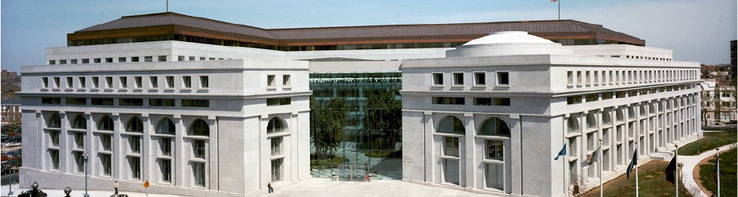
Federal Judicial Center
“…TO FURTHER THE DEVELOPMENT AND ADOPTION OF IMPROVED JUDICIAL ADMINISTRATION THROUGH EDUCATION & RESEARCH.”

Slide 3
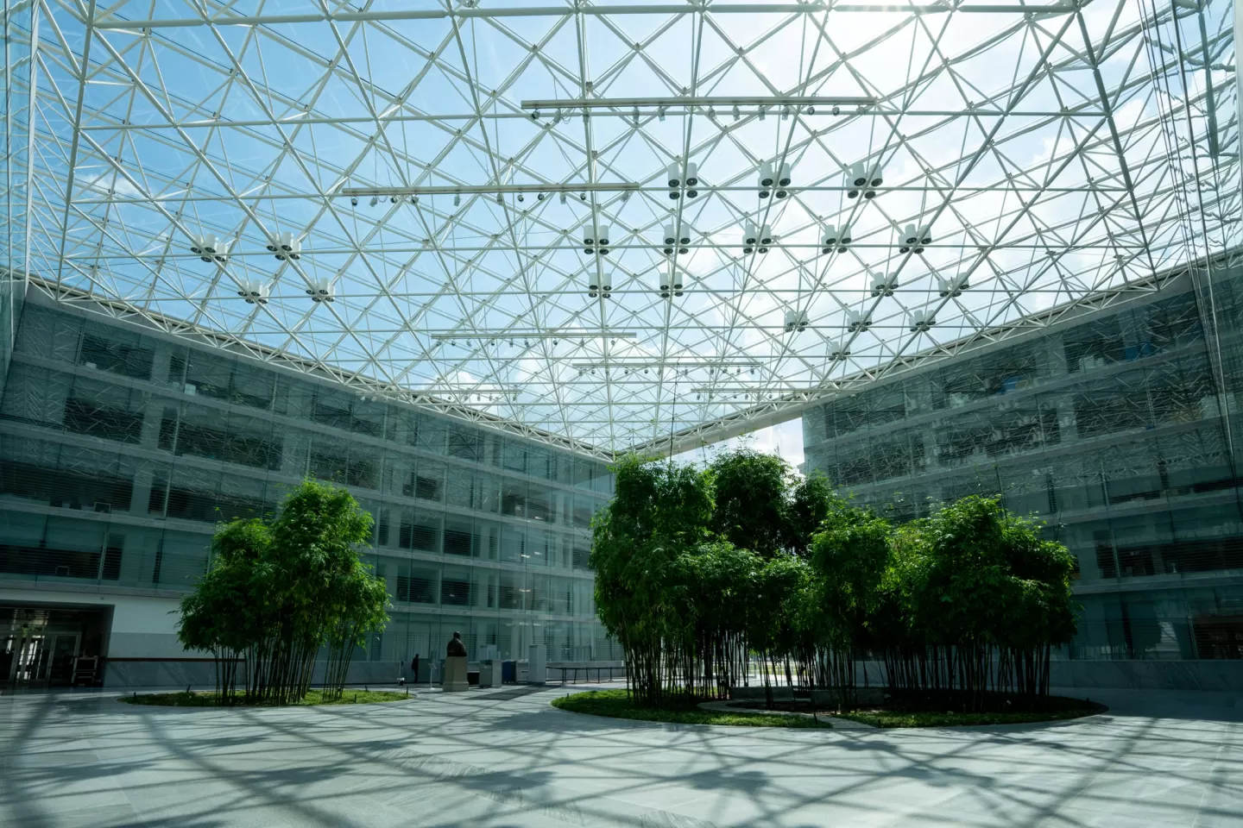
Federal Judicial Center
A judicial branch agency, established in 1967
Research
Examine and evaluate federal court practices and policies through empirical research
Education
Develop and implement programs and publications for newly appointed and experienced judges and court personnel
International
Programs and resources

Slide 4
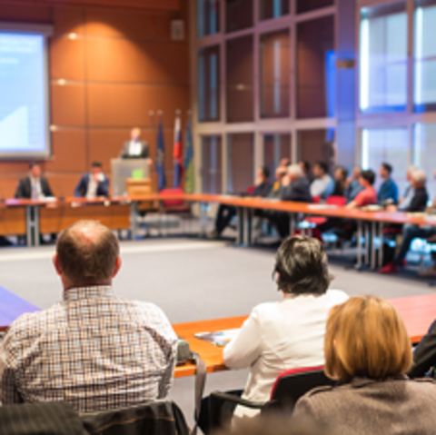
Judicial Education Topics
  Law and Procedure
  Evidentiary Issues
  Courtroom Skills
  Case Management
  Judgment Writing
  Judicial Ethics

Slide 5

New Paradigm

Slide 6

Competencies
Knowledge
Skills
Values

Slide 7

Bangalore Principles of Judicial Conduct: Value 6
  Competence and diligence are
  to the due performance of judicial office
prerequisites

Slide 8

What are ‘core’ digital competencies for judges?

Slide 9

Knowledge
Digital Forensics
Cybercrime
Cryptocurrency and Blockchain
Electronic Evidence
Artificial Intelligence

Slide 10

Electronic Evidence
Basics
Generated
Collected
Preserved (chain of custody)
Admissibility
Relevance
Authenticity: genuine, not manipulated
Integrity: reliable, not corrupted
Expert Testimony

Slide 11

Concepts and Terms
Machine Learning
Algorithms
Large Language Models
Training
Deep Fakes
Capabilities
Evidentiary Issues
  Relevance
  Reliability
  Authenticity
  Fairness
Future Trends
Artificial Intelligence

Slide 12
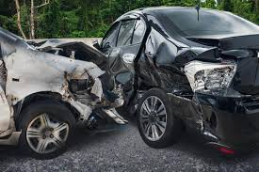

Damages Assessment
Victim Impact Statements

Slide 13

Skills
Electronic Filing
Digital Case Management
Videoconferencing
Hybrid Hearings
Cybersecurity

Slide 14
Ransom-ware
Third Party Access
Data Breach
Malware
Cybersecurity Threats to the Courts
Phishing
Denial of Service

Slide 15
How can you detect a phishing email?
Mismatched email address
Generic greeting
Unfamiliar sender
Unusual or vague request
All of the above
Notes:
https://www.amjmed.com/article/S0002-9343(16)31217-7/pdf - :~:text=Current morning or noontime lectures,reasons%3A working memory and interference

Slide 16

Cybersecurity Guidelines
Developed by Judiciary Taskforce
(led by judges)
Government Equipment
Zero Trust Architecture
Multi-factor Authentication
No Public Wi-Fi
Mandatory Training

Slide 17
Values
Public Trust and Confidence
Privacy and Confidentiality
Social Media
Cybersecurity
Ethical Implications of AI
Bias
Impact of algorithms
Digital Equity

Slide 18
Training on Digital Competencies: Challenges

Slide 19


Slide 20
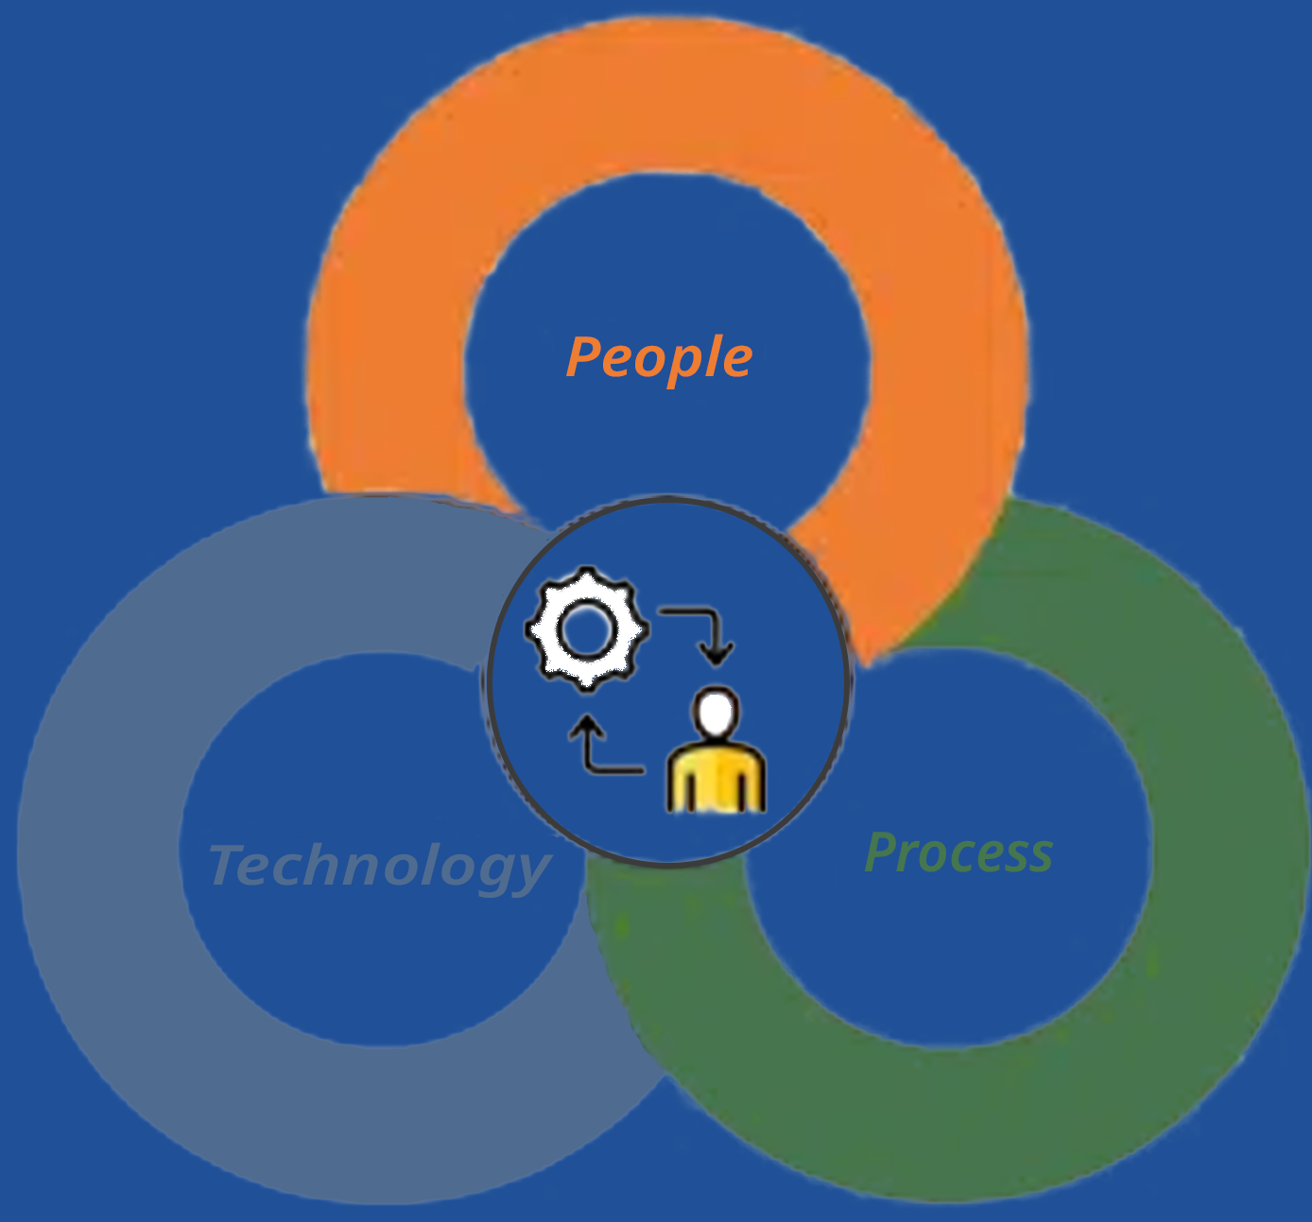
Change Management
Minimize Disruptions
Maximize Benefit
Manage Resistance
and Concerns
Plan and Prepare
Communicate
Train and Support

Slide 21

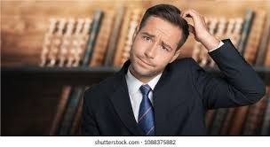

Slide 22
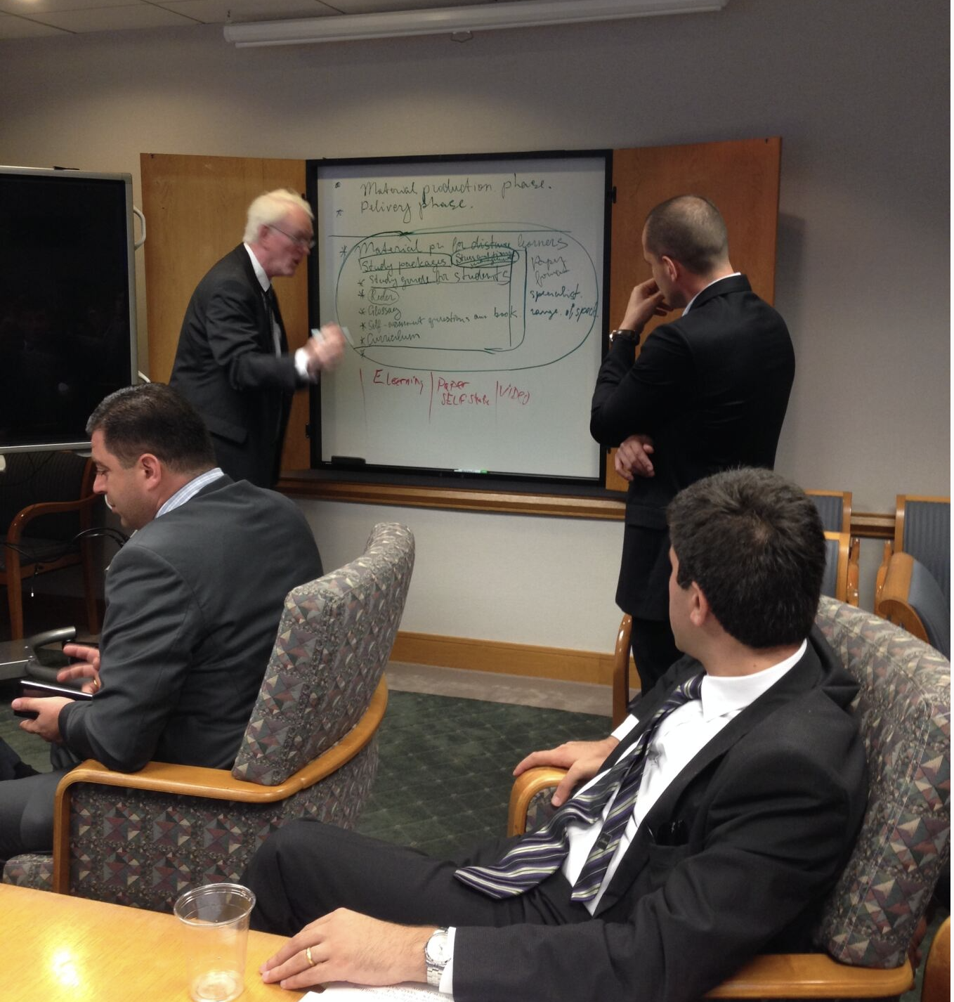
For Judges,
By Judges

Slide 23
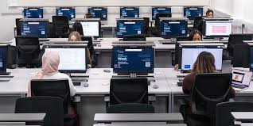
Judicial IT Curriculum

Slide 24


